Slide 1
Memory Management
Module 4:

Slide 2
Topics
Memory Management Requirements
Memory Partitioning:
Fixed Partitioning
Dynamic Partitioning
Memory Allocation Strategies:
Best-Fit
First Fit
Worst Fit
Paging and Segmentation
TLB
Virtual Memory:
Demand Paging
Page Replacement Strategies:
FIFO
Optimal
LRU
Thrashing

Slide 3

Memory Management Requirements
Memory management is intended to satisfy the following requirements:
Relocation
Protection
Sharing
Logical organization
Physical organization

Slide 4
Relocation
Relocation is the process of adjusting program addresses to match the actual physical addresses where the program resides when it executes
Why is relocation needed?
Programmer/translator don’t know which other programs will be memory resident when the program executes

Slide 5
Relocation
Why is relocation needed? (continued)
Active processes need to be able to be swapped in and out of main memory in order to maximize processor utilization
Specifying that a process must be placed in the same memory region when it is swapped back in would be limiting memory utilization
Consequently it must be possible to adjust addresses whenever a program is loaded.

Slide 6
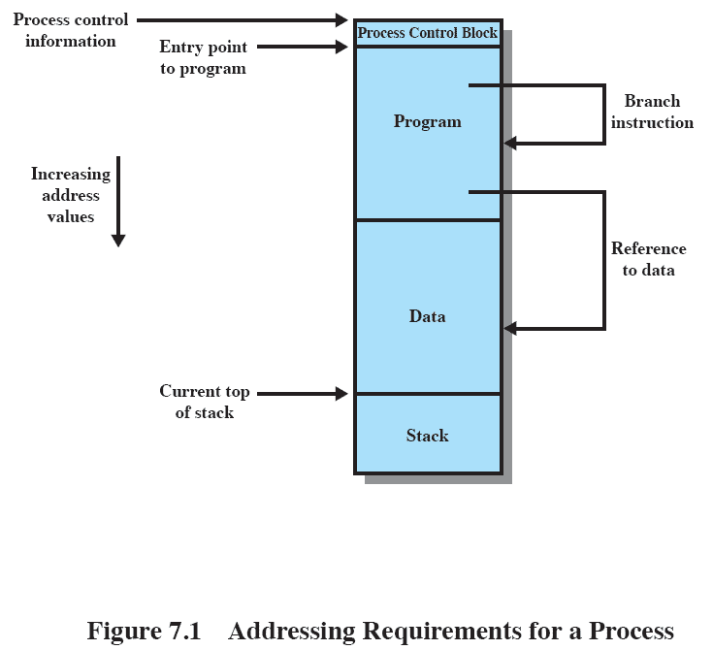
Addressing Requirements
Simplified Process Image

Slide 7
Protection
Processes need to acquire permission to reference memory locations for reading or writing purposes
Location of a program in main memory is unpredictable till execution begins
Memory references generated by a process must be checked at run time
Mechanisms that support relocation also support protection

Slide 8
Sharing
Advantageous to allow each process access to the same copy of the program rather than have their own separate copy
Memory management must allow controlled access to shared areas of memory without compromising protection
Mechanisms used to support relocation support sharing capabilities

Slide 9
Logical Organization
Main memory is organized as a linear (1-D) address space consisting of a sequence of bytes or words.
Programs aren’t necessarily organized this way
Paging versus segmentation
Programs are written in modules
modules can be written and compiled independently
different degrees of protection given to modules (read-only, execute-only)
sharing on a module level corresponds to the user’s way of viewing the problem

Slide 10
Physical Organization
Two-level memory for program storage:
Disk (slow and cheap) & RAM (fast and more expensive)
Main memory is volatile, disk isn’t
User should not have to be responsible for organizing movement of code/data between the two levels.

Slide 11
Physical Organization
Cannot leave the programmer with the responsibility to manage memory
Memory available for a program plus its data may be insufficient
overlaying allows various modules to be assigned the same region of memory but is time consuming to program
Programmer does not know how much space will be available

Slide 12
Memory Partitioning
Virtual memory management brings processes into main memory for execution by the processor
involves virtual memory
based on segmentation and paging
Partitioned memory management
used in several variations in some now-obsolete operating systems
does not involve virtual memory

Slide 13
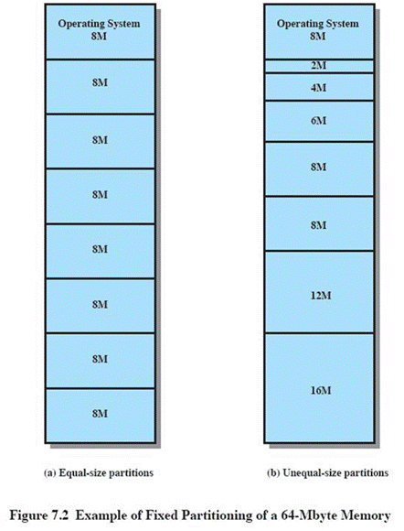
Fixed Partitioning
Equal-size partitions
any process whose size is less than or equal to the partition size can be loaded into an available partition
The operating system can swap out a process if all partitions are full and no process is in the Ready or Running state

Slide 14
Disadvantages
A program may be too big to fit in a partition
program needs to be designed with the use of overlays
Main memory utilization is inefficient
any program, regardless of size, occupies an entire partition
internal fragmentation
wasted space due to the block of data loaded being smaller than the partition

Slide 15
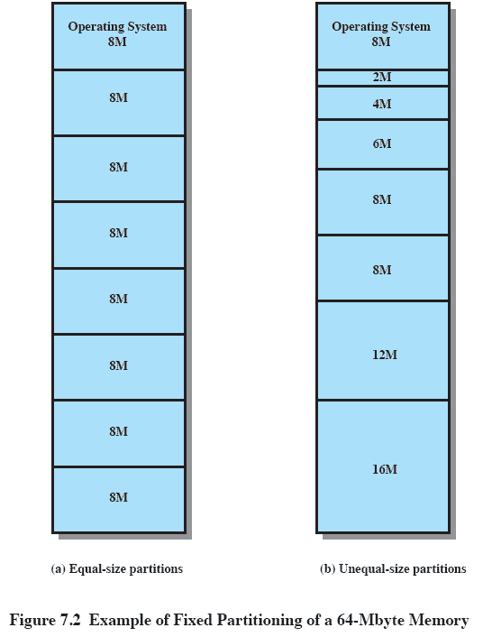
Unequal Size Partitions
Using unequal size partitions helps lessen the problems
programs up to 16M can be accommodated without overlays
partitions smaller than 8M allow smaller programs to be accommodated with less internal fragmentation

Slide 16
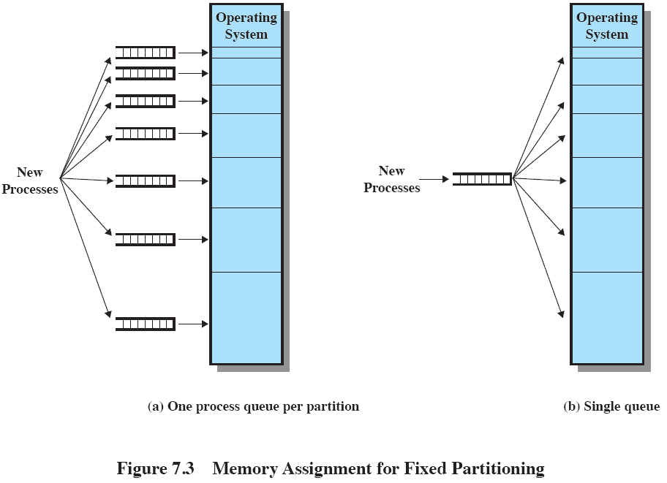
Memory Assignment
Fixed Partitioning

Slide 17
Disadvantages
The number of partitions specified at system generation time limits the number of active processes in the system
Small jobs will not utilize partition space efficiently

Slide 18
Dynamic Partitioning
Partitions are of variable length and number
Process is allocated exactly as much memory as it requires
This technique was used by IBM’s mainframe operating system, OS/MVT

Slide 19
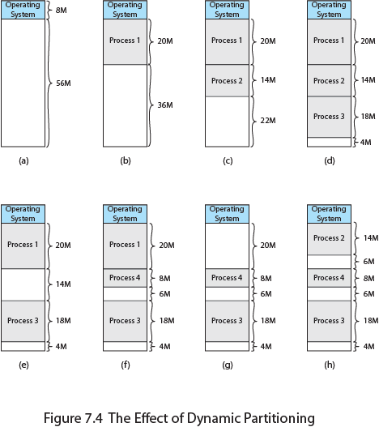
Effect of Dynamic Partitioning

Slide 20
Dynamic Partitioning
External Fragmentation
memory becomes more and more fragmented
memory utilization declines
Compaction
Technique for overcoming external fragmentation
OS shifts processes so that they are contiguous
free memory is together in one block
time consuming and wastes CPU time

Slide 21
Placement Algorithms
Best-fit
chooses the hole that is closest in size to the request
First-fit
begins to scan memory from the beginning and chooses the first available hole that is large enough
Next-fit
Worst-Fit
begins to scan memory from the location of the last placement and chooses the next available hole that is large enough
begins to scan memory from the beginning and chooses the largest available hole that is large enough

Slide 22
Placement Algorithms
How to satisfy a request of size n from a list of free holes?
First-fit: Allocate the first hole that is big enough
Best-fit: Allocate the smallest hole that is big enough; must search entire list, unless ordered by size
Produces the smallest leftover hole
Worst-fit: Allocate the largest hole; must also search entire list
Produces the largest leftover hole
First-fit and best-fit better than worst-fit in terms of speed and storage utilization

Slide 23
Placement Algorithms
First fit-fast
Next fit-starts search wherever it is
Slightly worse
Best fit-smallest hole that fits
Slower, results in a bunch of small holes (i.e. worse algorithm)
Worst fit-largest hole that fits
Not good (simulation results)

Slide 24
First Fit Sum
Given 5 memory partitions of 250kB, 300kB, 100kB, 200kB, 350kB (in order), how would the first fit algorithm place processes of 70kB, 30kB, 250kB (in order).
Let the memory partitions be:
B1 – 250kB
B2 – 300kB
B3 – 100kB
B4 – 200kB
B5 – 350kB
Let the processes be:
P1 – 70kB
P2 – 30kB
P3 – 250kB

Slide 25
First Fit solution
P1 – 70kB, P2 – 30kB, P3 – 250kB
Block 1 | Block 2 | Block 3 | Block 4 | Block 5
250kB | 300kB | 100kB | 200kB | 350kB
Block 1 |  | Block 2 | Block 3 | Block 4 | Block 5
P1 | 180kB | 300kB | 100kB | 200kB | 350kB
Block 1 |  |  | Block 2 | Block 3 | Block 4 | Block 5
P1 | P2 | 150kB | 300kB | 100kB | 200kB | 350kB
Block 1 |  |  | Block 2 |  | Block 3 | Block 4 | Block 5
P1 | P2 | 150kB | P3 | 50kB | 100kB | 200kB | 350kB

Slide 26
Best Fit sum
Given 5 memory partitions of 250kB, 300kB, 100kB, 200kB, 350kB (in order), how would the best fit algorithm place processes of 80kB, 100kB, 250kB (in order).
Let the memory partitions be:
B1 – 250kB
B2 – 300kB
B3 – 100kB
B4 – 200kB
B5 – 350kB
Let the processes be:
P1 – 80kB
P2 – 100kB
P3 – 250kB

Slide 27
Best Fit solution
P1 – 80kB, P2 – 100kB, P3 – 250kB
Block 1 | Block 2 | Block 3 | Block 4 | Block 5
250kB | 300kB | 100kB | 200kB | 350kB
Block 1 | Block 2 | Block 3 |  | Block 4 | Block 5
250kB | 300kB | P1 | 20kB | 200kB | 350kB
Block 1 | Block 2 | Block 3 |  | Block 4 |  | Block 5
250kB | 300kB | P1 | 20kB | P2 | 100kB | 350kB
Block 1 | Block 2 | Block 3 |  | Block 4 |  | Block 5
P3 | 300kB | P1 | 20kB | P2 | 100kB | 350kB

Slide 28
Worst Fit sum
Given 5 memory partitions of 250kB, 300kB, 100kB, 200kB, 350kB (in order), how would the worst fit algorithm place processes of 80kB, 100kB, 250kB (in order).
Let the memory partitions be:
B1 – 250kB
B2 – 300kB
B3 – 100kB
B4 – 200kB
B5 – 350kB
Let the processes be:
P1 – 80kB
P2 – 100kB
P3 – 250kB

Slide 29
Worst Fit solution
P1 – 80kB, P2 – 100kB, P3 – 250kB
Block 1 | Block 2 | Block 3 | Block 4 | Block 5
250kB | 300kB | 100kB | 200kB | 350kB
Block 1 | Block 2 | Block 3 | Block 4 | Block 5
250kB | 300kB | 100kB | 200kB | P1 | 270kB
Block 1 | Block 2 |  | Block 3 | Block 4 | Block 5
250kB | P2 | 200kB | 100kB | 200kB | P1 | 270kB
Block 1 | Block 2 |  | Block 3 | Block 4 | Block 5
250kB | P2 | 200kB | 100kB | 200kB | P1 | P3 | 20kB

Slide 30
Next Fit sum
Given 5 memory partitions of 250kB, 300kB, 100kB, 200kB, 350kB (in order), how would the next fit algorithm place processes of 70kB, 30kB, 250kB (in order).
Let the memory partitions be:
B1 – 250kB
B2 – 300kB
B3 – 100kB
B4 – 200kB
B5 – 350kB
Let the processes be:
P1 – 70kB
P2 – 30kB
P3 – 250kB

Slide 31
Next Fit solution
P1 – 70kB, P2 – 30kB, P3 – 250kB
Block 1 | Block 2 | Block 3 | Block 4 | Block 5
250kB | 300kB | 100kB | 200kB | 350kB
Block 1 |  | Block 2 | Block 3 | Block 4 | Block 5
P1 | 180kB | 300kB | 100kB | 200kB | 350kB
Block 1 |  | Block 2 |  | Block 3 | Block 4 | Block 5
P1 | 180kB | P2 | 270kB | 100kB | 200kB | 350kB
Block 1 |  | Block 2 |  | Block 3 | Block 4 | Block 5
P1 | 180kB | P2 | 270kB | 100kB | 200kB | P3 | 250kB

Slide 32
Example
Given 5 memory partitions of 100kB, 500kB, 200kB, 300kB, 600kB (in order), how would the first fit, best fit and worst fit algorithms place processes of 212kB, 417kB, 112kB, 426kB (in order).
Let the memory partitions be:
B1 – 100kB
B2 – 500kB
B3 – 200kB
B4 – 300kB
B5 – 600kB
Let the processes be:
P1 – 212kB
P2 – 417kB
P3 – 112kB
P4 – 426kB

Slide 33
First fit
P1 – 212kB, P2 – 417kB, P3 – 112kB, P4 – 426kB
426kB finds no slot available that it can occupy.
Block 1 | Block 2 | Block 3 | Block 4 | Block 5
100kB | 500kB | 200kB | 300kB | 600kB
Block 1 | Block 2 |  | Block 3 | Block 4 | Block 5
100kB | P1 | 288kB | 200kB | 300kB | 600kB
Block 1 | Block 2 |  | Block 3 | Block 4 | Block 5
100kB | P1 | 288kB | 200kB | 300kB | P2 | 183kB
Block 1 | Block 2 |  |  | Block 3 | Block 4 | Block 5
100kB | P1 | P3 | 176kB | 200kB | 300kB | P2 | 183kB

Slide 34
Best Fit
P1 – 212kB, P2 – 417kB, P3 – 112kB, P4 – 426kB
Block 1 | Block 2 | Block 3 | Block 4 | Block 5
100kB | 500kB | 200kB | 300kB | 600kB
Block 1 | Block 2 | Block 3 | Block 4 |  | Block 5
100kB | 500kB | 200kB | P1 | 88kB | 600kB
Block 1 | Block 2 |  | Block 3 | Block 4 |  | Block 5
100kB | P2 | 83kB | 200kB | P1 | 88kB | 600kB
Block 1 | Block 2 |  | Block 3 |  | Block 4 |  | Block 5
100kB | P2 | 83kB | P3 | 88kB | P1 | 88kB | 600kB
Block 1 | Block 2 |  | Block 3 |  | Block 4 |  | Block 5
100kB | P2 | 83kB | P3 | 88kB | P1 | 88kB | P4 | 174kB

Slide 35
Worst Fit
P1 – 212kB, P2 – 417kB, P3 – 112kB, P4 – 426kB
426kB finds no slot available that it can occupy.
Block 1 | Block 2 | Block 3 | Block 4 | Block 5
100kB | 500kB | 200kB | 300kB | 600kB
Block 1 | Block 2 | Block 3 | Block 4 | Block 5
100kB | 500kB | 200kB | 300kB | P1 | 388kB
Block 1 | Block 2 |  | Block 3 | Block 4 | Block 5
100kB | P2 | 83kB | 200kB | 300kB | P1 | 388kB
Block 1 | Block 2 |  | Block 3 | Block 4 | Block 5
100kB | P2 | 83kB | 200kB | 300kB | P1 | P3 | 276kB
Best Fit Algorithm makes the most efficient use of memory since all the process requests are allocated memory.

Slide 36

Fragmentation
External Fragmentation – total memory space exists to satisfy a request, but it is not contiguous
Internal Fragmentation – allocated memory may be slightly larger than requested memory; this size difference is memory internal to a partition, but not being used
First fit analysis reveals that given N blocks allocated, 0.5 N blocks lost to fragmentation
1/3 may be unusable -> 50-percent rule

Slide 37
Fragmentation (Cont.)
Reduce external fragmentation by compaction
Shuffle memory contents to place all free memory together in one large block
Compaction is possible only if relocation is dynamic, and is done at execution time
I/O problem
Latch job in memory while it is involved in I/O
Do I/O only into OS buffers
Now consider that backing store has same fragmentation problems

Slide 38
Segmentation
Memory-management scheme that supports user view of memory
A program is a collection of segments
A segment is a logical unit such as:
main program
procedure
function
method
object
local variables, global variables
common block
stack
symbol table
arrays

Slide 39
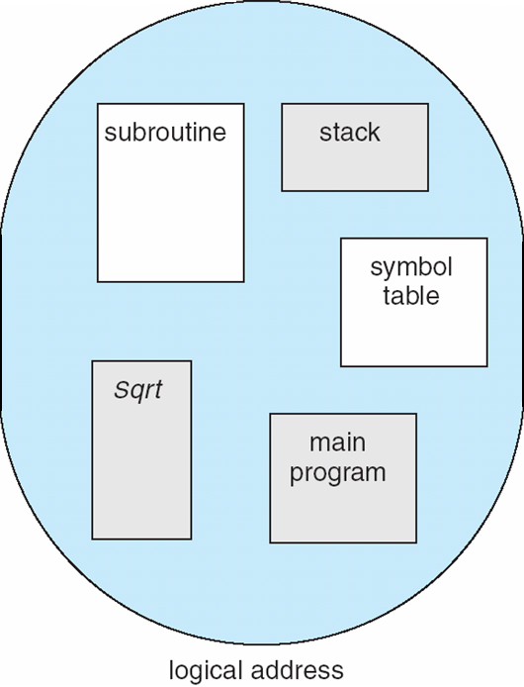
User’s View of a Program

Slide 40

Logical View of Segmentation
1
1
4
2
3
4
2
3
user space
physical memory space

Slide 41
Segmentation Architecture
Logical address consists of a two tuple:
<segment-number, offset>
Segment table – maps two-dimensional physical addresses; each table entry has:
base – contains the starting physical address where the segments reside in memory
limit – specifies the length of the segment
Segment-table base register (STBR) points to the segment table’s location in memory
Segment-table length register (STLR) indicates number of segments used by a program;
segment number s is legal if s < STLR

Slide 42
Segmentation Architecture (Cont.)
Protection
With each entry in segment table associate:
validation bit = 0 ⇒ illegal segment
read/write/execute privileges
Protection bits associated with segments; code sharing occurs at segment level
Since segments vary in length, memory allocation is a dynamic storage-allocation problem
A segmentation example is shown in the following diagram

Slide 43
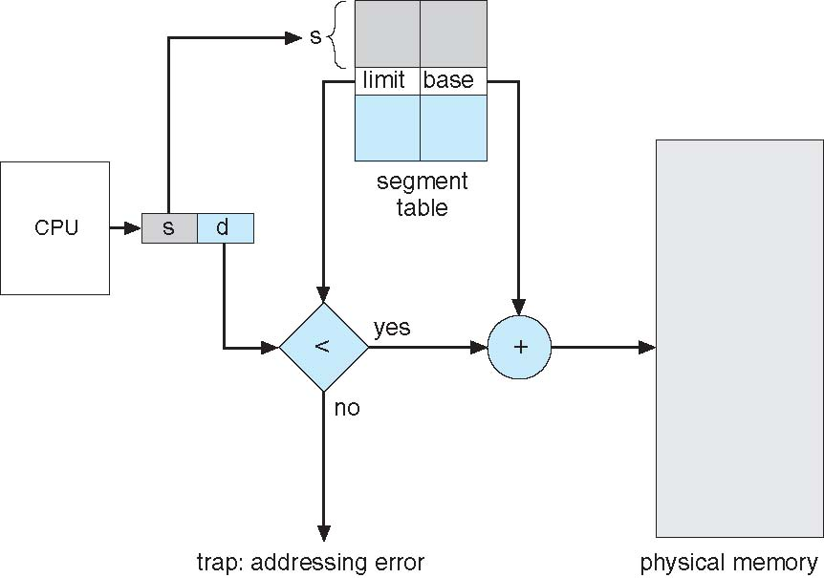
Segmentation Hardware

Slide 44
Paging
Physical address space of a process can be noncontiguous; process is allocated physical memory whenever the latter is available
Avoids external fragmentation
Avoids problem of varying sized memory chunks
Divide physical memory into fixed-sized blocks called frames
Size is power of 2, between 512 bytes and 16 Mbytes
Divide logical memory into blocks of same size called pages
Keep track of all free frames
To run a program of size N pages, need to find N free frames and load program
Set up a page table to translate logical to physical addresses
Backing store likewise split into pages
Still have Internal fragmentation

Slide 45
Address Translation Scheme
Address generated by CPU is divided into:
Page number (p) – used as an index into a page table which contains base address of each page in physical memory
Page offset (d) – combined with base address to define the physical memory address that is sent to the memory unit
For given logical address space 2^{m} and page size 2^{n}

Slide 46
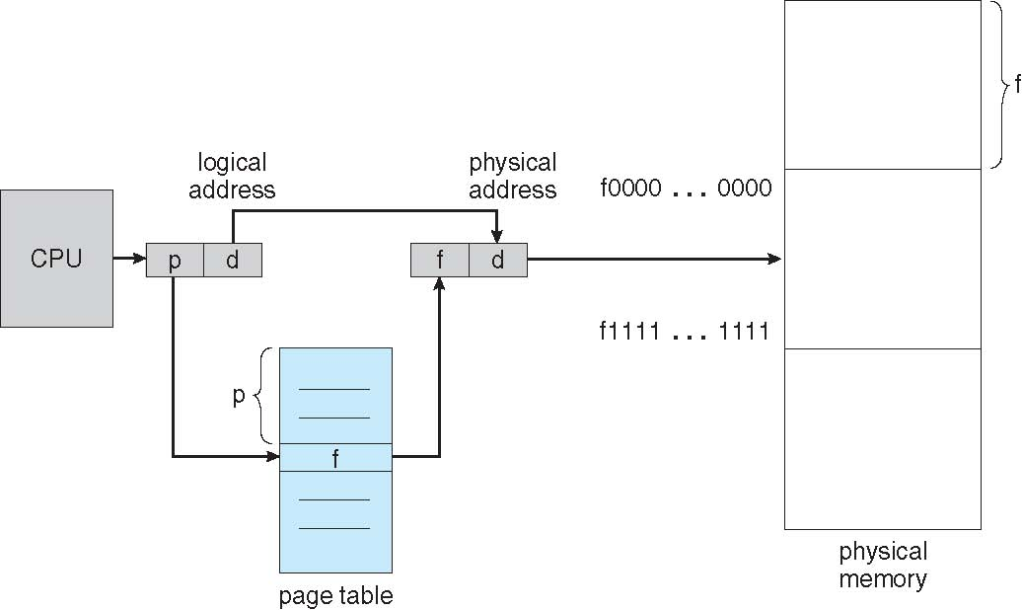
Paging Hardware

Slide 47

Paging Model of Logical and Physical Memory

Slide 48

Paging Example
n=2 and m=4 32-byte memory and 4-byte pages

Slide 49
Paging
Calculating internal fragmentation
Page size = 8kB
Process size = 34kB
4 pages + 2kB
Internal fragmentation of 4 - 2= 2kB
Worst case fragmentation = 1 frame – 1 byte

Slide 50
Paging (Cont.)
Calculating internal fragmentation
Page size = 2,048 bytes
Process size = 72,766 bytes
35 pages + 1,086 bytes
Internal fragmentation of 2,048 - 1,086 = 962 bytes
Worst case fragmentation = 1 frame – 1 byte
On average fragmentation = 1 / 2 frame size
So small frame sizes desirable?
But each page table entry takes memory to track
Page sizes growing over time
Solaris supports two page sizes – 8 KB and 4 MB
Process view and physical memory now very different
By implementation process can only access its own memory

Slide 51

Free Frames
Before allocation
After allocation

Slide 52
Implementation of Page Table
Page table is kept in main memory
Page-table base register (PTBR) points to the page table
Page-table length register (PTLR) indicates size of the page table
In this scheme every data/instruction access requires two memory accesses
One for the page table and one for the data / instruction
The two memory access problem can be solved by the use of a special fast-lookup hardware cache called associative memory or translation look-aside buffers (TLBs)

Slide 53
Implementation of Page Table (Cont.)
Some TLBs store address-space identifiers (ASIDs) in each TLB entry – uniquely identifies each process to provide address-space protection for that process
Otherwise need to flush at every context switch
TLBs typically small (64 to 1,024 entries)
On a TLB miss, value is loaded into the TLB for faster access next time
Replacement policies must be considered
Some entries can be wired down for permanent fast access

Slide 54
Associative Memory
Associative memory – parallel search
Address translation (p, d)
If p is in associative register, get frame # out
Otherwise get frame # from page table in memory

Slide 55

Paging Hardware With TLB https://www.youtube.com/watch?v=95QpHJX55bM – Paging with TLB

Slide 56
Effective Access Time
Associative Lookup = ε time unit
Can be < 10% of memory access time
Hit ratio = α
Hit ratio – percentage of times that a page number is found in the associative registers; ratio related to number of associative registers
Consider α = 80%, ε = 20ns for TLB search, 100ns for memory access
Effective Access Time (EAT)
EAT = (1 + ε) α + (2 + ε)(1 – α)
= 2 + ε – α
Consider α = 80%, ε = 20ns for TLB search, 100ns for memory access
EAT = 0.80 x 100 + 0.20 x 200 = 120ns
Consider more realistic hit ratio -> α = 99%, ε = 20ns for TLB search, 100ns for memory access
EAT = 0.99 x 100 + 0.01 x 200 = 101ns

Slide 57
Memory Protection
Memory protection implemented by associating protection bit with each frame to indicate if read-only or read-write access is allowed
Can also add more bits to indicate page execute-only, and so on
Valid-invalid bit attached to each entry in the page table:
“valid” indicates that the associated page is in the process’ logical address space, and is thus a legal page
“invalid” indicates that the page is not in the process’ logical address space
Or use page-table length register (PTLR)
Any violations result in a trap to the kernel

Slide 58

Valid (v) or Invalid (i) Bit In A Page Table

Slide 59
Structure of the Page Table
Memory structures for paging can get huge using straight-forward methods
Consider a 32-bit logical address space as on modern computers
Page size of 4 KB (2¹²)
Page table would have 1 million entries (2³² / 2¹²)
If each entry is 4 bytes -> 4 MB of physical address space / memory for page table alone
That amount of memory used to cost a lot
Don’t want to allocate that contiguously in main memory
Hierarchical Paging
Hashed Page Tables
Inverted Page Tables

Slide 60
Hierarchical Page Tables
Break up the logical address space into multiple page tables
A simple technique is a two-level page table
We then page the page table

Slide 61

Two-Level Page-Table Scheme

Slide 62
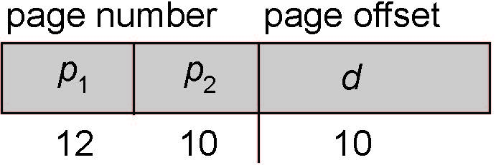
Two-Level Paging Example
A logical address (on 32-bit machine with 1K page size) is divided into:
a page number consisting of 22 bits
a page offset consisting of 10 bits
Since the page table is paged, the page number is further divided into:
a 12-bit page number
a 10-bit page offset
Thus, a logical address is as follows:
where p₁ is an index into the outer page table, and p₂ is the displacement within the page of the inner page table
Known as forward-mapped page table

Slide 63

Address-Translation Scheme

Slide 64
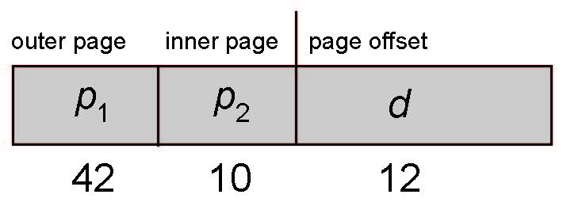
64-bit Logical Address Space
Even two-level paging scheme not sufficient
If page size is 4 KB (2¹²)
Then page table has 2⁵² entries
If two level scheme, inner page tables could be 2¹⁰ 4-byte entries
Address would look like
Outer page table has 2⁴² entries or 2⁴⁴ bytes
One solution is to add a 2nd outer page table
But in the following example the 2nd outer page table is still 2³⁴ bytes in size
And possibly 4 memory access to get to one physical memory location

Slide 65


Three-level Paging Scheme

Slide 66
Virtual Memory
Virtual memory – separation of user logical memory from physical memory
Only part of the program needs to be in memory for execution
Logical address space can therefore be much larger than physical address space
Allows address spaces to be shared by several processes
Allows for more efficient process creation
More programs running concurrently
Less I/O needed to load or swap processes

Slide 67
Virtual Memory
Virtual address space – logical view of how process is stored in memory
Usually start at address 0, contiguous addresses until end of space
Meanwhile, physical memory organized in page frames
MMU must map logical to physical
Virtual memory can be implemented via:
Demand paging
Demand segmentation

Slide 68
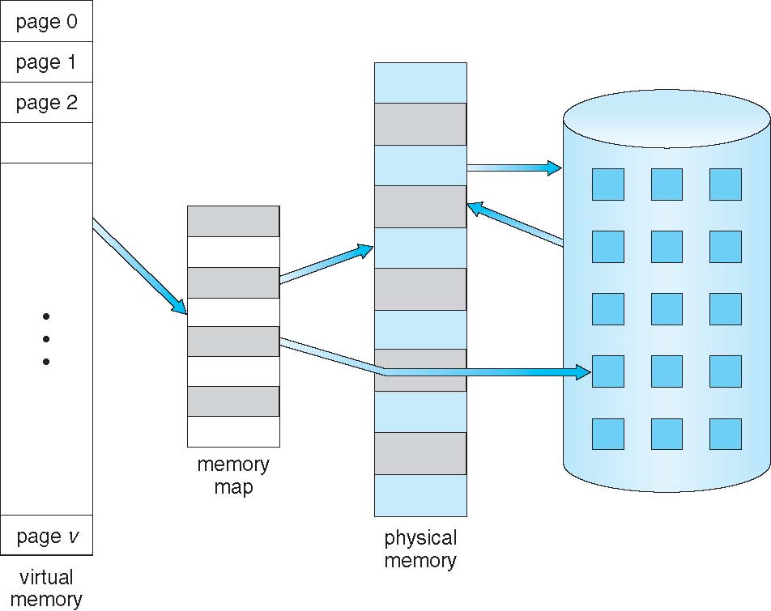
Virtual Memory That is Larger Than Physical Memory

Slide 69
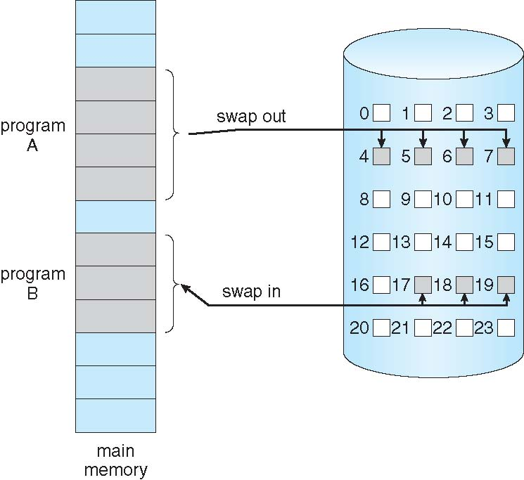
Demand Paging
Could bring entire process into memory at load time
Or bring a page into memory only when it is needed
Less I/O needed, no unnecessary I/O
Less memory needed
Faster response
More users
Similar to paging system with swapping (diagram on right)
Page is needed ⇒ reference to it
invalid reference ⇒ abort
not-in-memory ⇒ bring to memory
Lazy swapper – never swaps a page into memory unless page will be needed
Swapper that deals with pages is a pager

Slide 70
Basic Concepts
With swapping, pager guesses which pages will be used before swapping out again
Instead, pager brings in only those pages into memory
How to determine that set of pages?
Need new MMU functionality to implement demand paging
If pages needed are already memory resident
No difference from non demand-paging
If page needed and not memory resident
Need to detect and load the page into memory from storage
Without changing program behavior
Without programmer needing to change code

Slide 71
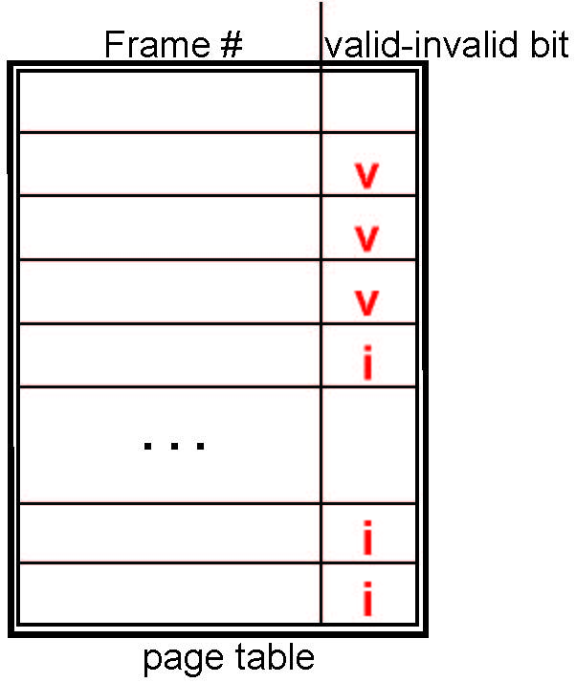
Valid-Invalid Bit
With each page table entry a valid–invalid bit is associated (v ⇒ in-memory – memory resident, i ⇒ not-in-memory)
Initially valid–invalid bit is set to i on all entries
Example of a page table snapshot:
During MMU address translation, if valid–invalid bit in page table entry is i ⇒ page fault

Slide 72
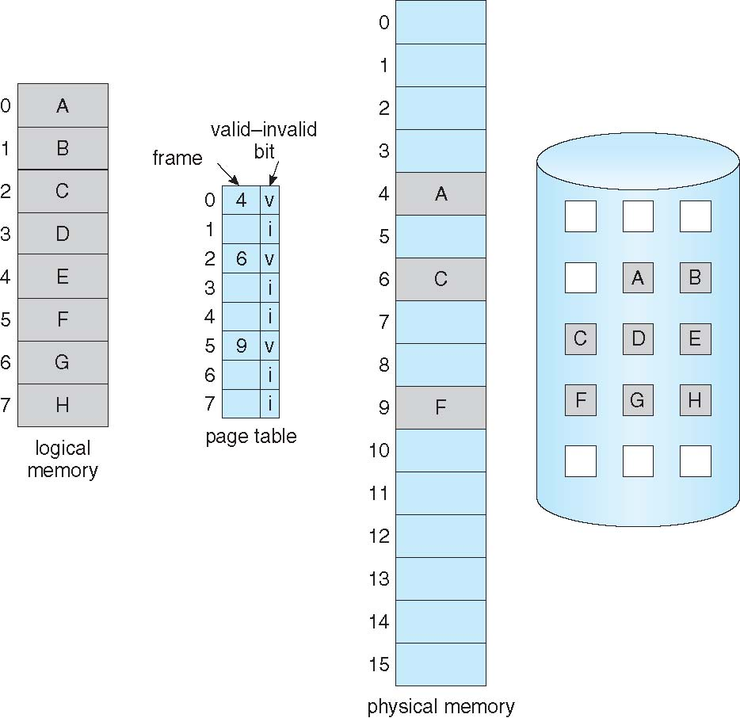
Page Table When Some Pages Are Not in Main Memory

Slide 73
Page Fault
If there is a reference to a page, first reference to that page will trap to operating system:
page fault
Operating system looks at another table to decide:
Invalid reference ⇒ abort
Just not in memory
Find free frame
Swap page into frame via scheduled disk operation
Reset tables to indicate page now in memory Set validation bit = v
Restart the instruction that caused the page fault

Slide 74

Steps in Handling a Page Fault

Slide 75
Aspects of Demand Paging
Extreme case – start process with no pages in memory
OS sets instruction pointer to first instruction of process, non-memory-resident -> page fault
And for every other process pages on first access
Pure demand paging
Actually, a given instruction could access multiple pages -> multiple page faults
Consider fetch and decode of instruction which adds 2 numbers from memory and stores result back to memory
Pain decreased because of locality of reference
Hardware support needed for demand paging
Page table with valid / invalid bit
Secondary memory (swap device with swap space)
Instruction restart

Slide 76
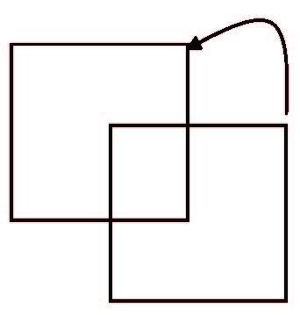
Instruction Restart
Consider an instruction that could access several different locations
block move
auto increment/decrement location
Restart the whole operation?
What if source and destination overlap?

Slide 77
Performance of Demand Paging
Stages in Demand Paging (worse case)
Trap to the operating system
Save the user registers and process state
Determine that the interrupt was a page fault
Check that the page reference was legal and determine the location of the page on the disk
Issue a read from the disk to a free frame:
Wait in a queue for this device until the read request is serviced
Wait for the device seek and/or latency time
Begin the transfer of the page to a free frame
While waiting, allocate the CPU to some other user
Receive an interrupt from the disk I/O subsystem (I/O completed)
Save the registers and process state for the other user
Determine that the interrupt was from the disk
Correct the page table and other tables to show page is now in memory
Wait for the CPU to be allocated to this process again
Restore the user registers, process state, and new page table, and then resume the interrupted instruction

Slide 78
Performance of Demand Paging (Cont.)
Three major activities
Service the interrupt – careful coding means just several hundred instructions needed
Read the page – lots of time
Restart the process – again just a small amount of time
Page Fault Rate 0 ≤ p ≤ 1
if p = 0 no page faults
if p = 1, every reference is a fault
Effective Access Time (EAT)
EAT = (1 – p) x memory access
+ p (page fault overhead
+ swap page out
+ swap page in )

Slide 79
Demand Paging Example
Memory access time = 200 nanoseconds
Average page-fault service time = 8 milliseconds
EAT = (1 – p) x 200 + p (8 milliseconds)
= (1 – p x 200 + p x 8,000,000
= 200 + p x 7,999,800
If one access out of 1,000 causes a page fault, then
EAT = 8.2 microseconds.
This is a slowdown by a factor of 40!!
If want performance degradation < 10 percent
220 > 200 + 7,999,800 x p 20 > 7,999,800 x p
p < .0000025
< one page fault in every 400,000 memory accesses

Slide 80
What Happens if There is no Free Frame?
Used up by process pages
Also in demand from the kernel, I/O buffers, etc
How much to allocate to each?
Page replacement – find some page in memory, but not really in use, page it out
Algorithm – terminate? swap out? replace the page?
Performance – want an algorithm which will result in minimum number of page faults
Same page may be brought into memory several times

Slide 81
Page Replacement
Prevent over-allocation of memory by modifying page-fault service routine to include page replacement
Use modify (dirty) bit to reduce overhead of page transfers – only modified pages are written to disk
Page replacement completes separation between logical memory and physical memory – large virtual memory can be provided on a smaller physical memory

Slide 82
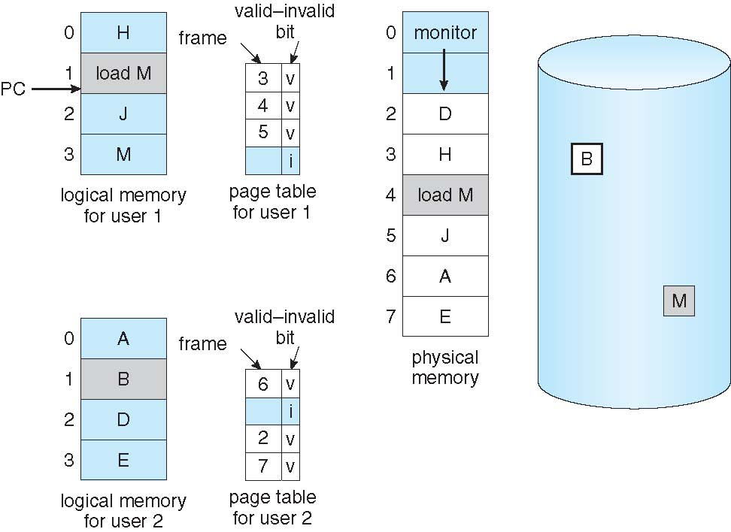
Need For Page Replacement

Slide 83
Basic Page Replacement
Find the location of the desired page on disk
Find a free frame: - If there is a free frame, use it - If there is no free frame, use a page replacement algorithm to select a victim frame - Write victim frame to disk if dirty
Bring the desired page into the (newly) free frame; update the page and frame tables
Continue the process by restarting the instruction that caused the trap
Note now potentially 2 page transfers for page fault – increasing EAT

Slide 84
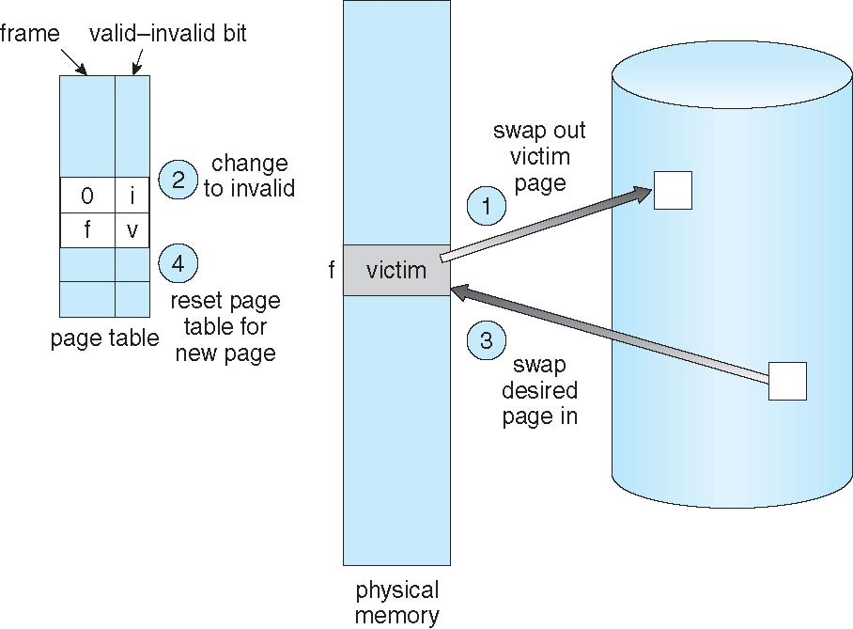
Page Replacement

Slide 85
Page and Frame Replacement Algorithms
Frame-allocation algorithm determines
How many frames to give each process
Which frames to replace
Page-replacement algorithm
Want lowest page-fault rate on both first access and re-access
Evaluate algorithm by running it on a particular string of memory references (reference string) and computing the number of page faults on that string
String is just page numbers, not full addresses
Repeated access to the same page does not cause a page fault
Results depend on number of frames available
In all our examples, the reference string of referenced page numbers is
7,0,1,2,0,3,0,4,2,3,0,3,0,3,2,1,2,0,1,7,0,1

Slide 86
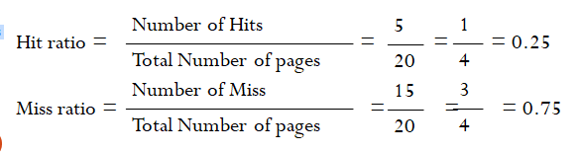
FIFO (First In First Out)
7 | 0 | 1 | 2 | 0 | 3 | 0 | 4 | 2 | 3 | 0 | 3 | 2 | 1 | 2 | 0 | 1 | 7 | 0 | 1
7
7
7
2
2
2
2
4
4
4
0
0
0
0
0
0
0
7
7
7
0
0
0
0
3
3
3
2
2
2
2
2
1
1
1
1
1
0
0
1
1
1
1
0
0
0
3
3
3
3
3
2
2
2
2
2
1
H
H
H
H
H

Slide 87
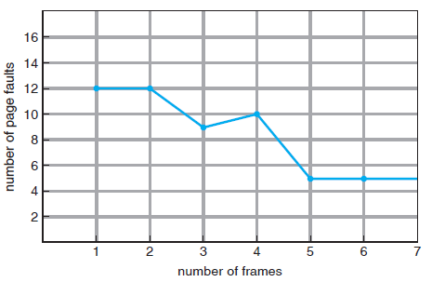
FIFO
It is expected that the number of Hits increase with increase in number of page frames.
Consider: 1, 2, 3, 4, 1, 2, 5, 1, 2, 3, 4, 5
Belady’s anomaly:
page-fault rate may
increase as the number of
allocated frames increases.

Slide 88
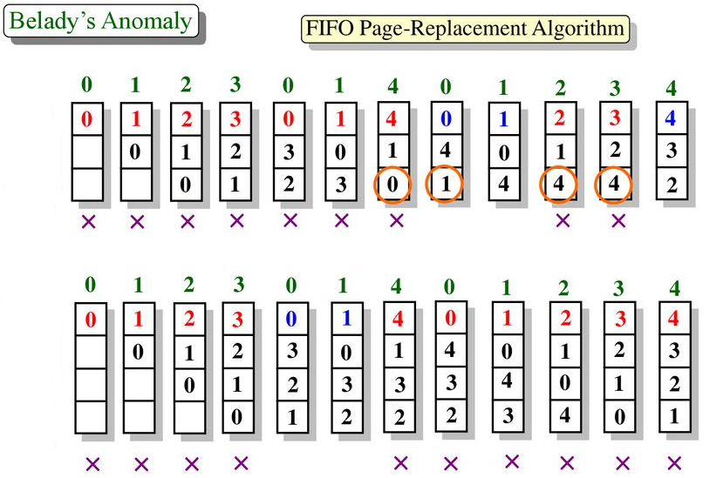
Belady’s Anomaly

Slide 89
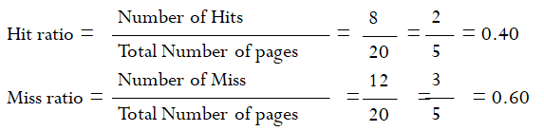
LRU (Least Recently Used)
7 | 0 | 1 | 2 | 0 | 3 | 0 | 4 | 2 | 3 | 0 | 3 | 2 | 1 | 2 | 0 | 1 | 7 | 0 | 1
7
7
7
2
2
2
2
4
4
4
0
0
0
1
1
1
1
1
1
1
0
0
0
0
0
0
0
0
3
3
3
3
3
3
0
0
0
0
0
1
1
1
3
3
3
2
2
2
2
2
2
2
2
2
7
7
7
H
H
H
H
H
H
H
H

Slide 90
LFU (Least Frequently Used)
7 | 0 | 1 | 2 | 0 | 3 | 0 | 4 | 2 | 3 | 0 | 3 | 2 | 1 | 2 | 0 | 1 | 7 | 0 | 1
7⁽¹⁾
7⁽¹⁾
7⁽¹⁾
2⁽¹⁾
2⁽¹⁾
2⁽¹⁾
2⁽¹⁾
4⁽¹⁾
4⁽¹⁾
3⁽¹⁾
3⁽¹⁾
3⁽²⁾
3⁽²⁾
1⁽¹⁾
1⁽¹⁾
1⁽¹⁾
1⁽²⁾
7⁽¹⁾
7⁽¹⁾
1⁽¹⁾
0⁽¹⁾
0⁽¹⁾
0⁽¹⁾
0⁽²⁾
0⁽²⁾
0⁽³⁾
0⁽³⁾
0⁽³⁾
0⁽³⁾
0⁽⁴⁾
0⁽⁴⁾
0⁽⁴⁾
0⁽⁴⁾
0⁽⁴⁾
0⁽⁵⁾
0⁽⁵⁾
0⁽⁵⁾
0⁽⁶⁾
0⁽⁶⁾
1⁽¹⁾
1⁽¹⁾
1⁽¹⁾
3⁽¹⁾
3⁽¹⁾
3⁽¹⁾
2⁽¹⁾
2⁽¹⁾
2⁽¹⁾
2⁽¹⁾
2⁽²⁾
2⁽²⁾
2⁽³⁾
2⁽³⁾
2⁽³⁾
2⁽³⁾
2⁽³⁾
2⁽³⁾
H
H
H
H
H
H
H
H
H
Hit Ratio = Number of Hits / Total number of access
= 9/ 20
= 0.45
Miss Ratio = Number of Miss / Total number of access
Or
= 1 – Hit Ratio
= 1 – 0.45
= 0.55

Slide 91
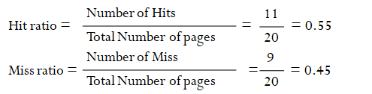
Optimal
7 | 0 | 1 | 2 | 0 | 3 | 0 | 4 | 2 | 3 | 0 | 3 | 2 | 1 | 2 | 0 | 1 | 7 | 0 | 1
7
7
7
2
2
2
2
2
2
2
2
2
2
2
2
2
2
7
7
7
0
0
0
0
0
0
4
4
4
0
0
0
0
0
0
0
0
0
0
1
1
1
3
3
3
3
3
3
3
3
1
1
1
1
1
1
1
H
H
H
H
H
H
H
H
H
H
H

Slide 92
Thrashing
If a process does not have “enough” pages, the page-fault rate is very high
Page fault to get page
Replace existing frame
But quickly need replaced frame back
This leads to:
Low CPU utilization
Operating system thinking that it needs to increase the degree of multiprogramming
Another process added to the system
Thrashing ≡ a process is busy swapping pages in and out

Slide 93
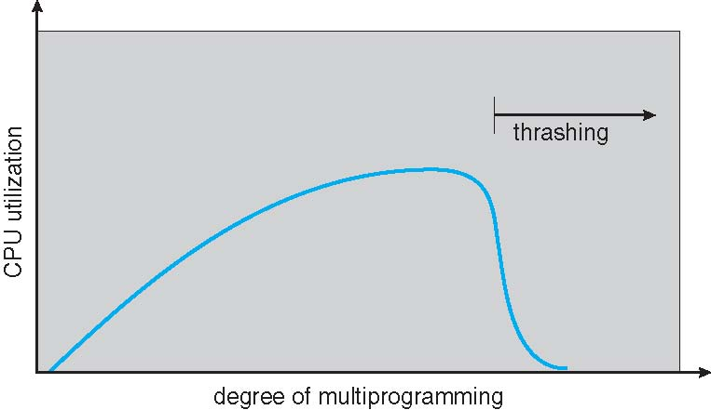
Thrashing

Slide 94
Demand Paging and Thrashing
Why does demand paging work? Locality model
Process migrates from one locality to another
Localities may overlap
Why does thrashing occur? Σ size of locality > total memory size
Limit effects by using local or priority page replacement

Slide 95
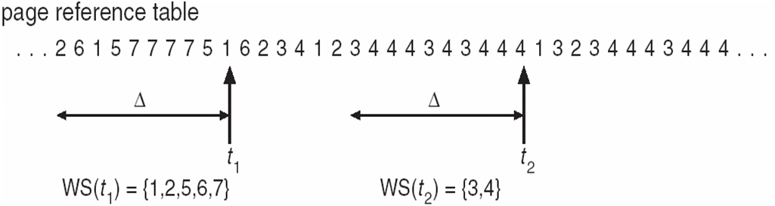
Working-Set Model
Δ ≡ working-set window ≡ a fixed number of page references Example: 10,000 instructions
WSS_{i} (working set of Process P_{i}) = total number of pages referenced in the most recent Δ (varies in time)
if Δ too small will not encompass entire locality
if Δ too large will encompass several localities
if Δ = ∞ ⇒ will encompass entire program
D = Σ WSS_{i} ≡ total demand frames
Approximation of locality
if D > m ⇒ Thrashing
Policy if D > m, then suspend or swap out one of the processes

Slide 96
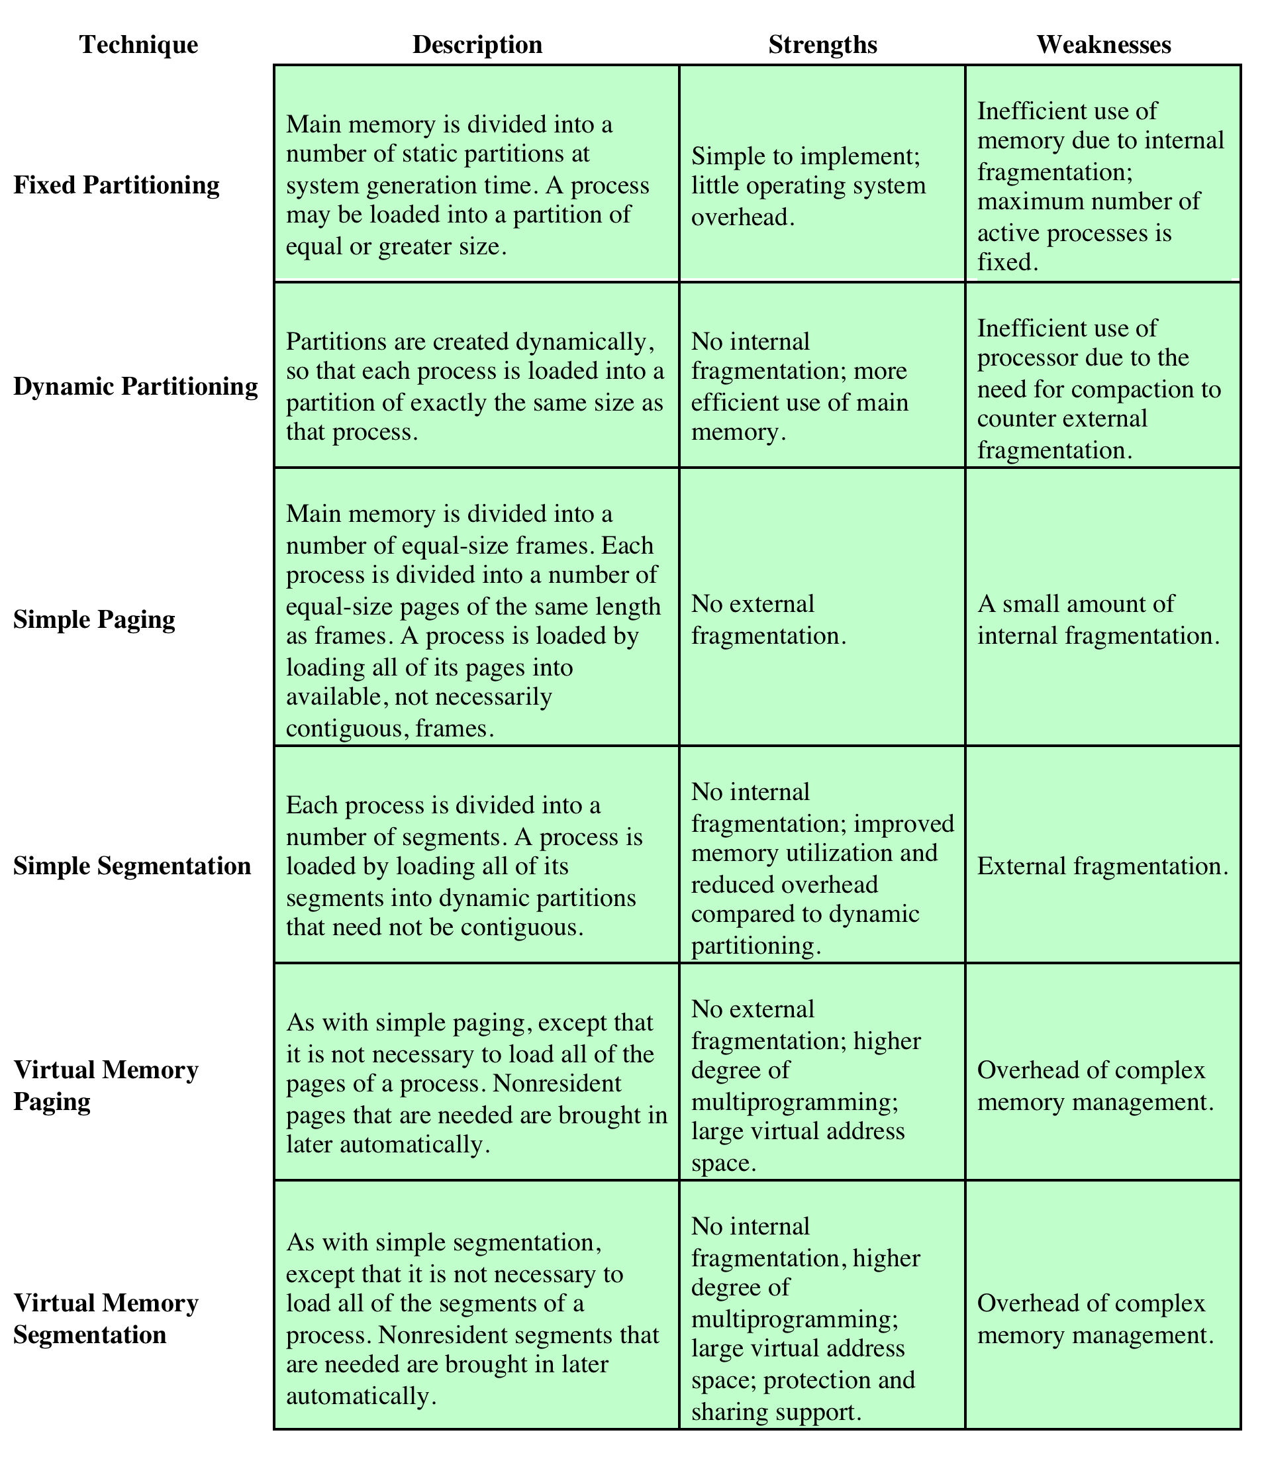
Memory Management Techniques

Slide 97
Thank You

